Slide 1

Use of Python in Finance and Economics

Slide 2

Python connects economics and data science
With Python, you can easily integrate the work of economists and data scientists into one solution/platform.
Python’s simplicity and flexibility have won the entire financial sector.

Slide 3
A business-oriented language
With Python, a more straightforward syntax means that many technical details are in the background, not distracting you from your business purpose.
You don’t have to use semicolons to delineate functions, loops, and lines the way it happens with other programming languages like C++/Java, etc. This way, you keep everything concise and save time.

Slide 4
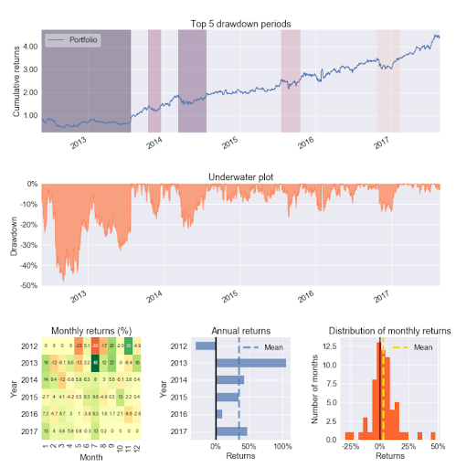
As an analytical tool
Python is widely used in quantitative finance - solutions that process and analyze large datasets, and big financial data. Libraries such as Pandas simplify the process of data visualization and allow the carrying out of sophisticated statistical calculations.
Thanks to libraries such as Scikit or PyBrain, Python-based solutions are equipped with powerful machine learning algorithms that enable predictive analytics, which is very valuable to all financial services providers.

Slide 5
An excellent banking software
Finance organizations build payment solutions and online banking platforms with Python as well. Venmo is an excellent example of a mobile banking platform that has grown into a full-fledged social network.
Thanks to its simplicity and flexibility, Python comes in handy for developing ATM software that enhances payment processing.

Slide 6
Cryptocurrency and algorithmic trading
Every business that sells cryptocurrency needs tools for carrying out cryptocurrency market data analysis to get insights and predictions.
The Python data science ecosystem called Anaconda helps developers to retrieve cryptocurrency pricing and analyze it or visualize financial data.
That's why most web applications that deal with cryptocurrency analysis take advantage of Python.
Stock markets generate massive amounts of financial data that require a lot of analysis. And that's where Python helps as well. Developers can use it to create solutions that identify the best stock trading strategies and offer actionable, predictive analytical insights into the condition of specific markets. Use cases include algorithmic trading in fintech products,

